Slide 1




Personalized Diet Recommendation System
Team - OkayNoted
Ansh Avi Khanna (IMT2021038)
Arjun Subhedar (IMT2021069)
Ritik Kumar Gupta (IMT2021098)
Pranav Bhutada (IMT2021105)
Github

Slide 2
Our Motivation
1.
2.
3.
4.
Making Healthy Eating Easy
Helping You Take Charge:
We're here to make it simple for everyone to eat well by suggesting personalized meals.
Our project gives you the tools to manage your health and make informed food choices.
Meeting Different Goals:
Building a Healthier Future:
Whether it's building muscle or keeping your heart healthy, we've got you covered with tailored recommendations.
By promoting balanced eating and sustainable habits, we're working towards a healthier tomorrow for everyone.

Slide 3
Introduction
Eating healthily is a challenge in today's world due to busy lifestyles and conflicting dietary advice.
Our project aims to simplify this by offering personalized diet recommendations for breakfast, lunch, and dinner.
By considering specific user attributes like weight, height, gender as well as individual goals like weight loss, muscle gain, or heart health, we tailor meal plans to meet specific needs.
With our system, users can make informed choices about their diet, leading to better health outcomes.

Slide 4


Dataset Creation & Scraping

Slide 5
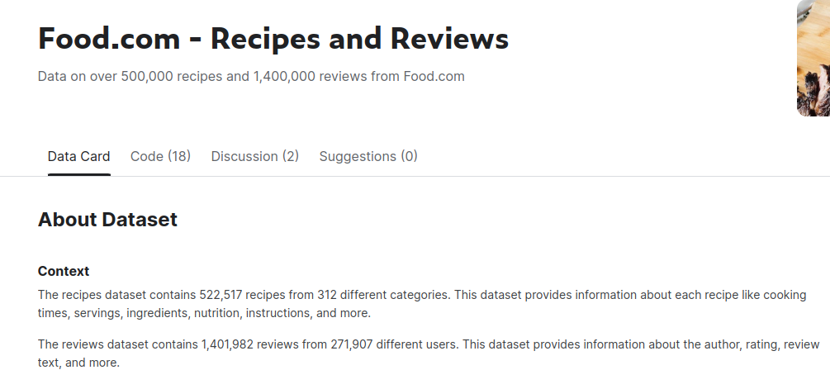
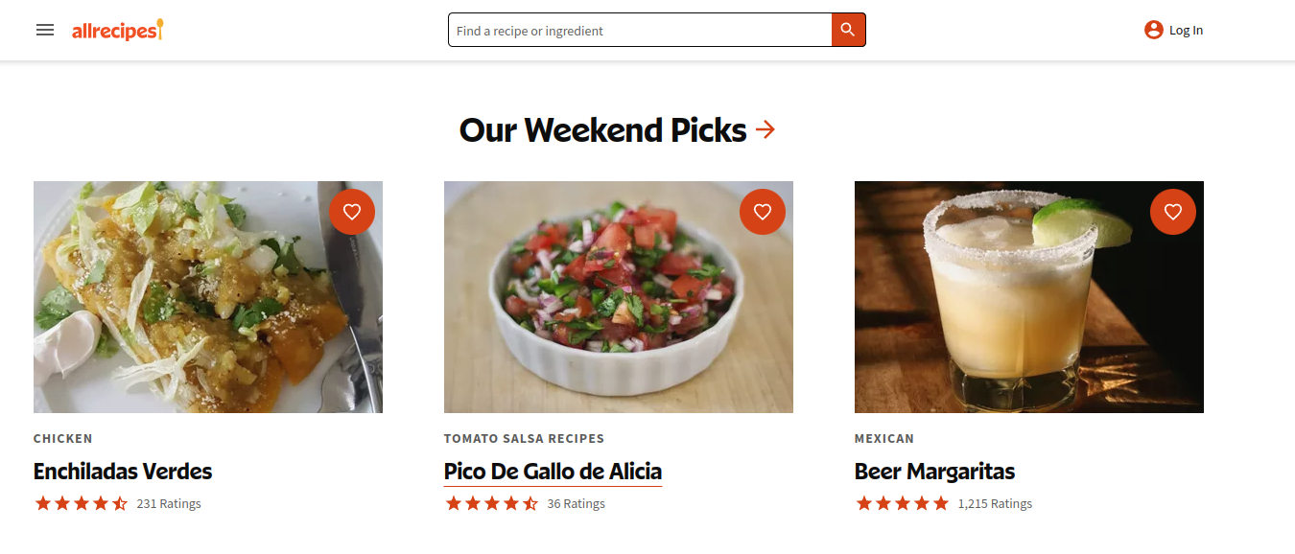

Food.com
AllRecipes.com
Initial Dataset Exploration:
Initially, we attempted to utilize datasets from both Kaggle and Food.com.
Encountered challenges with a significant number of NaN values in the dataset.
Identified difficulties in categorizing meals into distinct categories like breakfast, lunch, and dinner due to the lack of clear labeling.
Alternative Approach: Scraping from AllRecipies.com:
As an alternative, we decided to scrape data directly from AllRecipies.com
This approach provided us with a superior dataset characterized by clearer meal labels and a reduction in missing data instances.

Slide 6
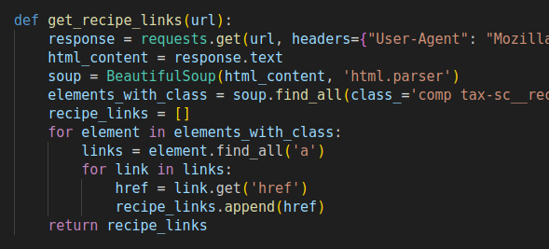
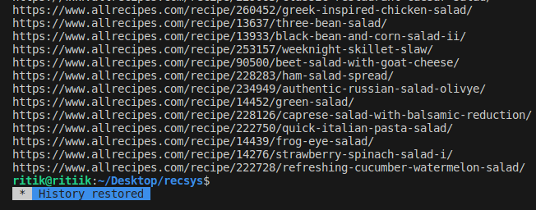
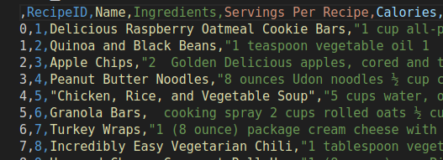
Dataset Scraping
We utilized the Python library Beautiful Soup for scraping data from AllRecipes.com.
Breakfast comprises 1,132 links, lunch comprises 480 links, and dinner comprises 840 links on AllRecipes.com.
The scraping process took approximately 1.5 - 2 hrs.
Finally, we created CSV files named breakfast.csv, lunch.csv, and dinner.csv.

Slide 7
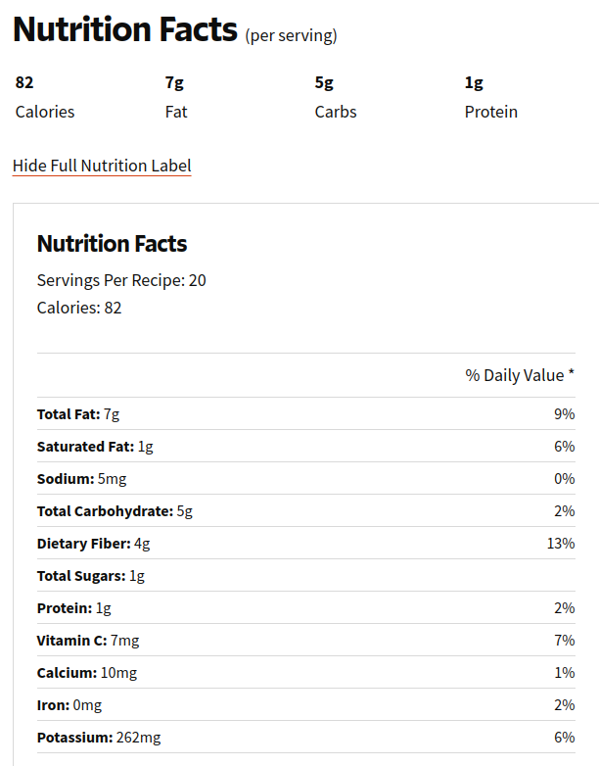
Dataset Scraping
These are the nutrition data available on the site, which best fits our needs. We scraped this data and included it as columns in our dataframe.
Philosophy: Our main idea was to keep things real. We wanted to use data that reflects how people actually eat every day. By getting information from AllRecipes.com, we aimed to give practical advice that fits real-life eating habits. This way, our recommendations could be more helpful and relevant to users.

Slide 8
Approach - 1
Contextual Multi-Armed Bandits, Linear UCB, Epsilon-Greedy

Slide 9



Data Preprocessing

Slide 10
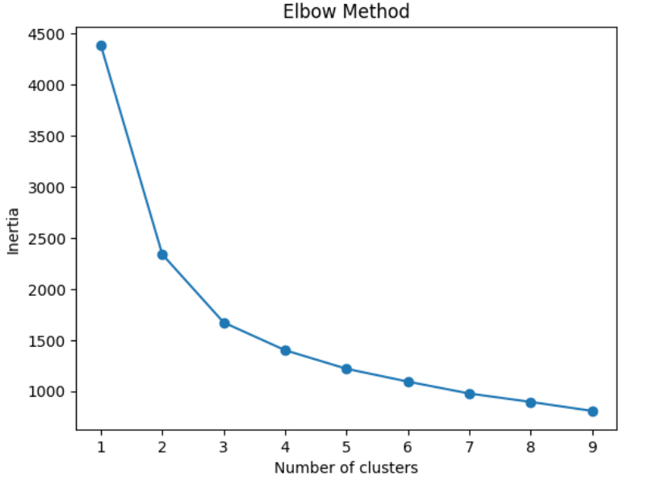
Dataset Preprocessing
Datasets: We have three datasets for breakfast, lunch and dinner recipes. The columns in these datasets are as follows - 'RecipeID', 'Name', 'Ingredients', 'Servings Per Recipe', 'calories', 'protein', 'carbohydrates', 'fat', 'saturated_fat', 'cholesterol', 'fiber', 'Sodium', 'Rating', 'Number of Ratings', 'URL'
Clustering: To do clustering in these three datasets, we first calculate the quantities of nutrients in each recipe for a 1000 calories (this is done in order to make the recipes comparable). Once this is done, the recipes are then clustered into 3, 4 and 4 clusters respectively for breakfast, lunch and dinner using K Means. The elbow graph shown is for clustering in breakfast dataframe.

Slide 11
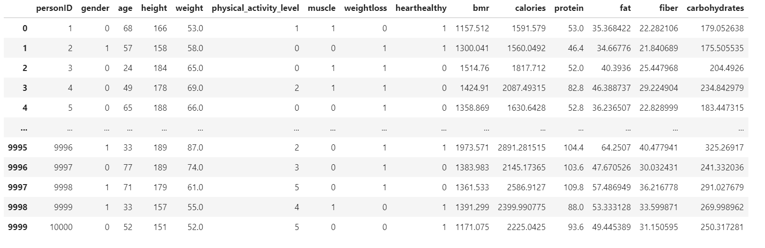
Dataset Preprocessing
User Dataset: User profiles are being synthetically generated.
Nutrient Calculation: The optimal nutrients for each user are calculated and appended to the row corresponding to the user in the dataset. This nutrient calculation has been done using BMR (basal metabolic rate) and physical activity level, and other formulas found upon research online.

Slide 12
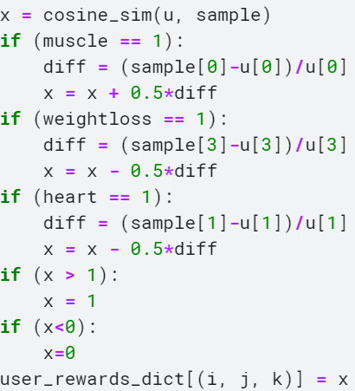
Reward Generation
An arm is defined by a combination of clusters from breakfast, lunch and dinner (i.e we have 3 x 4 x 3 = 36 combos or arms).
For each user, we iterate over all arms (combos). Each arm is defined by a combination of clusters as mentioned above. So, arm 0 is defined by the cluster combo (0, 0 , 0). Similarly, arm 1 is defined as (0, 0 ,1), arm 2 as (0, 0, 2), arm 3 as (0, 1, 0) etc. We sample a recipe randomly from clusters i , j and k for an arm defined by (i, j , k).
We then calculate the reward as shown in the code on left.

Slide 13
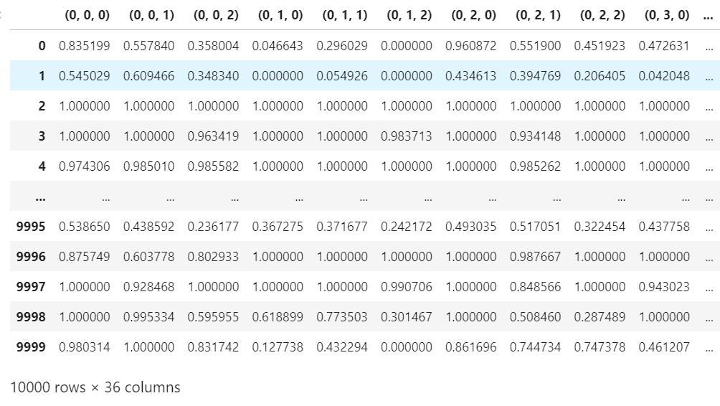
Reward Generation

Slide 14
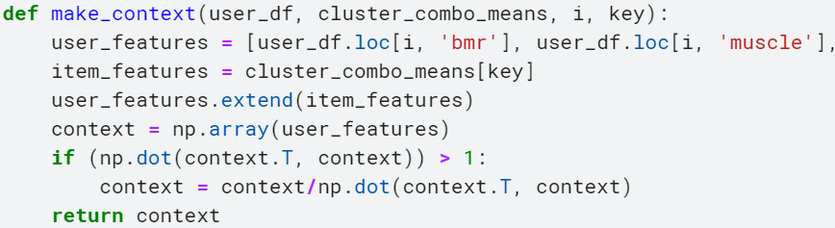
Context Formation
In contextual bandits, context represents a combination of a user and an arm.
User’s context is defined by BMR, activity level, muscle goal, weight loss goal, heart healthy goal.
Arms context is defined by the vector denoting nutrients for a particular combo.
We concatenate the two vectors to form the context.

Slide 15
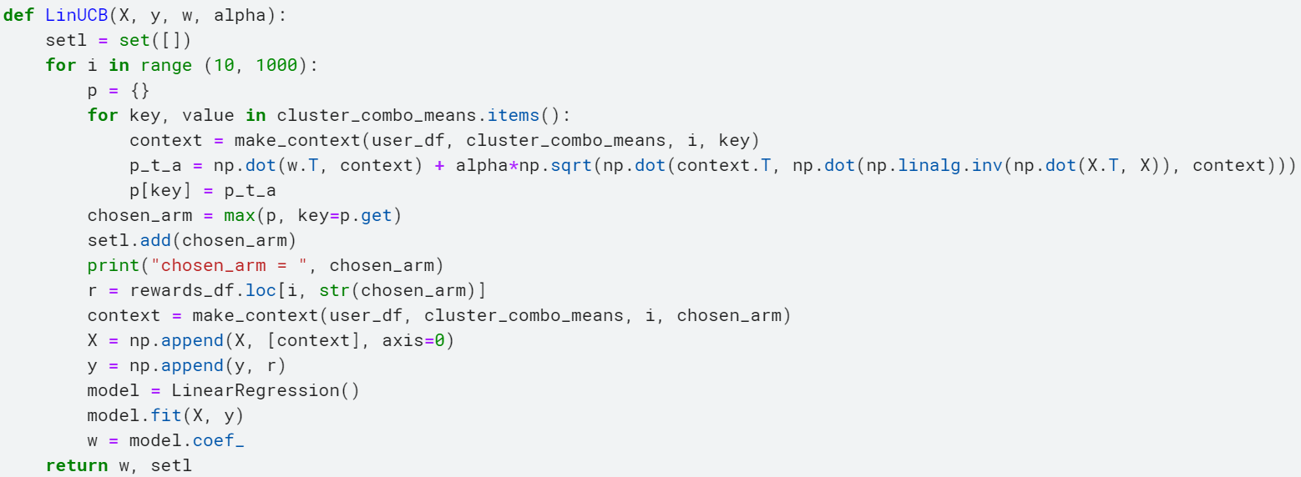
LinUCB
We first tried using Linear UCB, whose code is shown below.

Slide 16
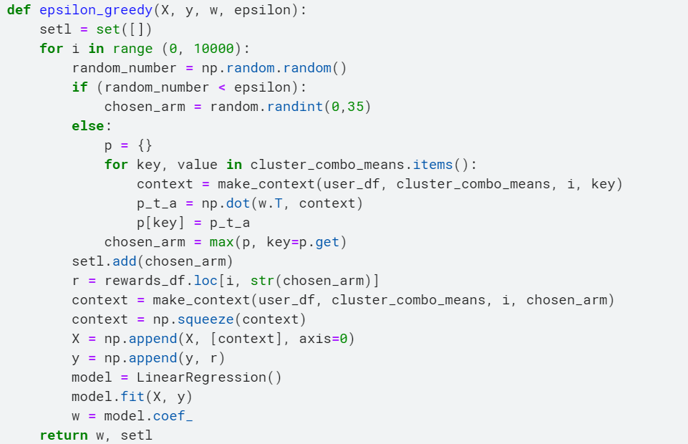
Epsilon-Greedy
We then used Epsilon-Greedy, whose code is shown below. We have taken epsilon to be 0.5.
We chose Epsilon-Greedy over Linear UCB because we realised that even upon experimenting with various values of alpha, the algorithm was not exploring all the arms which is undesirable.

Slide 17
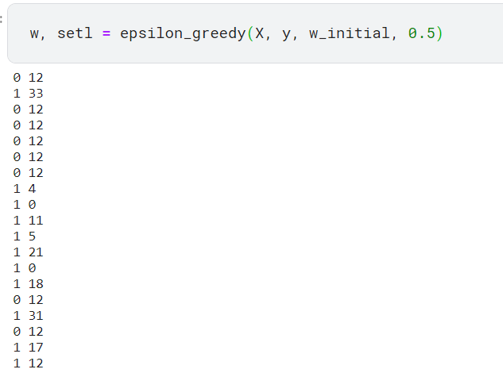
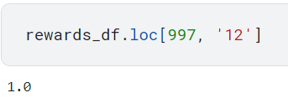
Results
By the end of the run of the algorithm, if for a user, we are doing exploitation, the best arm should be picked upon exploitation.
This means that, that particular arm should have the highest reward in the rewards dataframe for that user.
It can be seen that at the 997th step, the arem chosen upon exploitation (0), is 12. And in rewards dataframe, the rewards for that arm is 1.

Slide 18
Challenges Faced
The main challenge faced was how to form the context vector to make it learnable. We tried various methods for this. Element wise addition of user and arm vector, tensor product between user and arm vector, Hadamard Product between the user and arm vector. But all these methods did not improve the performance of the model, it was almost same as the performance as concatenation of the two vectors.
Defining rewards was a difficult task. We first tried the converse of the norm of the different between user and sample vector. Then we went on to do the similarity metric with some noise so as to make the rewards stochastic. Finally, random sampling made the most sense since in real life too people would pick random recipes.
Clustering recipes on what basis was also a challenge.
We also faced many errors initially during algorithm implementation. Most of them were input shape related.

Slide 19
Approach - 2
Recommendations, Ratings, Epsilon Greedy, Decaying epsilon

Slide 20
Data Preprocessing

Slide 21
Filtering According to Diet Goal
Filtering recipes based on diet goals by setting appropriate thresholds on nutrient values.
Muscle Gain
Heart Healthy
Focus on high protein intake.
Promote foods low in saturated fats and rich in fruits, vegetables

Slide 22
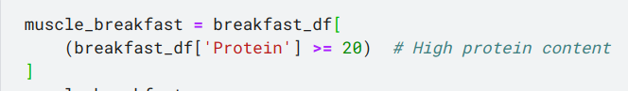
Muscle Gain
Below are the constraints for filtering recipes from the dataset for users who want to gain muscle.
Reference for above thresholds

Slide 23
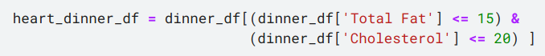
Heart Healthy
Below are the constraints for filtering recipes from the dataset for users who want to prioritize heart health.
Reference for above thresholds

Slide 24
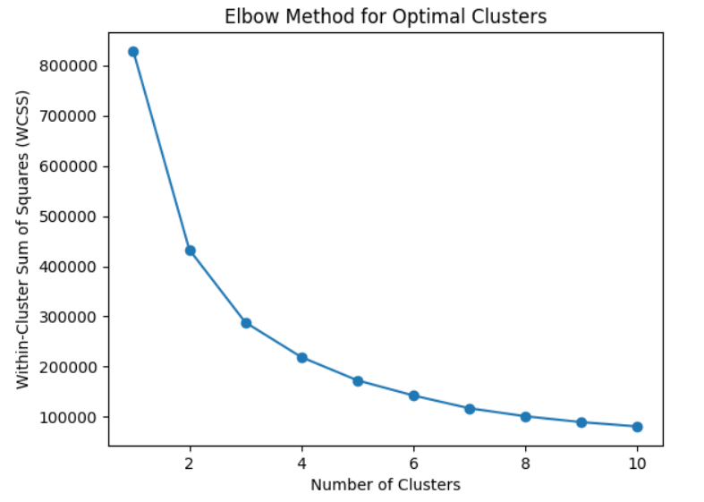
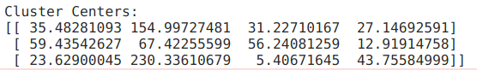
Clustering
We did clustering for each of the filtered data frames using k-means++.
And then choose the optimal number of clusters using elbow method.
According to the graph choosing 3 as the optimal clusters and applying k-means++ with number of clusters as 3

Slide 25
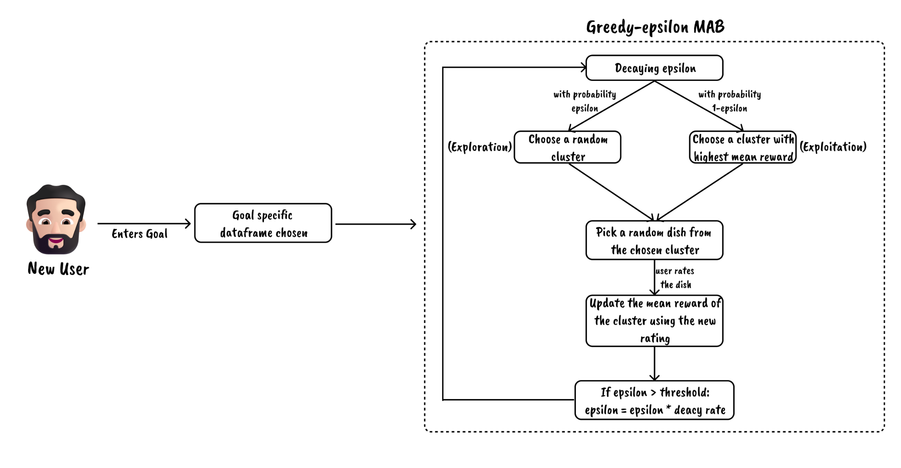
Greedy Epsilon MAB

Slide 26
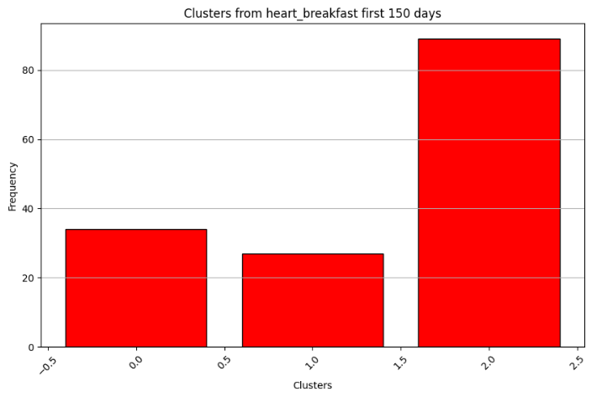
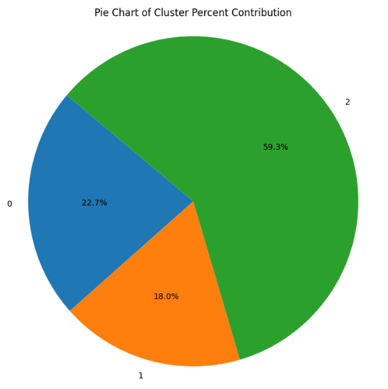
Results
To test run our system, we have generated 365 random ratings that would be given for breakfast recommendations of each day for 365 days. Below are the visualizations depicting the frequency of chosen arms (clusters).
For first 150 days.

Slide 27
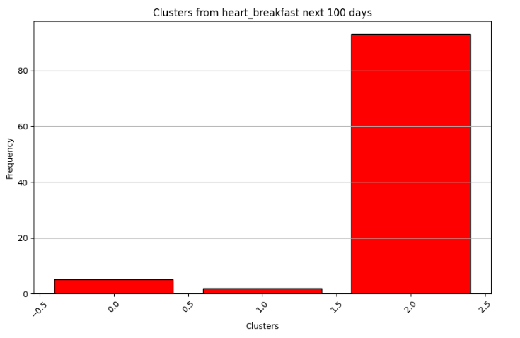
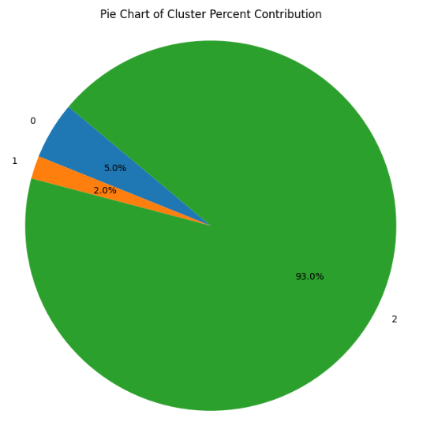
Results
2. For Next 100 days.

Slide 28
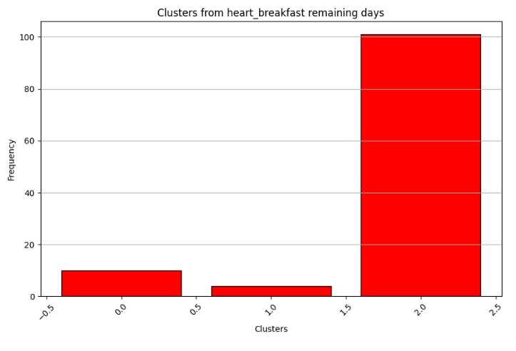
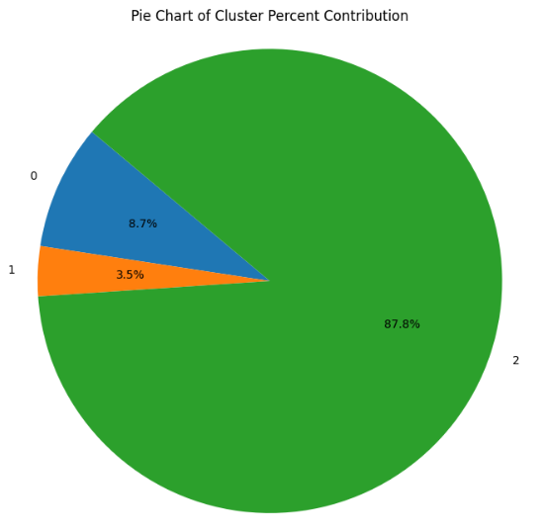
Results
3. For Remaining days.

Slide 29
Challenges &
Improvements

Slide 30
1. Clustering of recipes: Clustering the recipes was a challenge as we wanted the clustering to be relevant to the taste of the food item. According to the research paper ^{[1]} nutrients like protein, carbohydrates, fats, etc influence the taste of the food item. Hence we applied kmeans on the nutrient values after scaling them to per 1000 calories.
2. Non desirable cluster being chosen majority of times during exploration initially: It so may happen during the initial phase where exploration is given priority, a specific cluster might get recommended everytime randomly and even though the user doesn’t prefer that cluster, the same cluster would be recommended during exploitation too as others mean would still be 0. Hence to tackle this initial mean ratings have been set to 2 instead of 0.
3. Epsilon becoming too small: Due to decaying epsilon, epsilon may become too small and exploration would never happen. This would lead to similar recommendations from there on. Hence we have put a lower bound on the value of epsilon such that it won’t decay below the lower bound so that a minimal amount of exploration would always persist.
[1] van Langeveld, Astrid & Gibbons, Shannon & Koelliker, Yvonne & Civille, Gail & de Vries, Jeanne & Graaf, Cees & Mars, Monica. (2016). The relationship between taste and nutrient content in commercially available foods from the United States. Food Quality and Preference. 57. 10.1016/j.foodqual.2016.10.012.

Slide 31
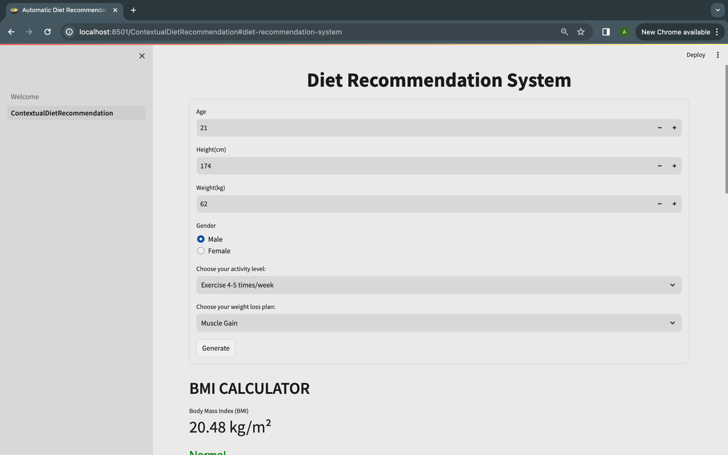
Deployment on Streamlit

Slide 32




Thanks!

